Slide 1
Move-out Sale
PICK UP IN EVGR B
Prices indicated OBO
Alt email: junhongt@alumni.stanford.edu
Venmo/Bank Transfers only
(GBP/SGD transfers possible too!)

Slide 2
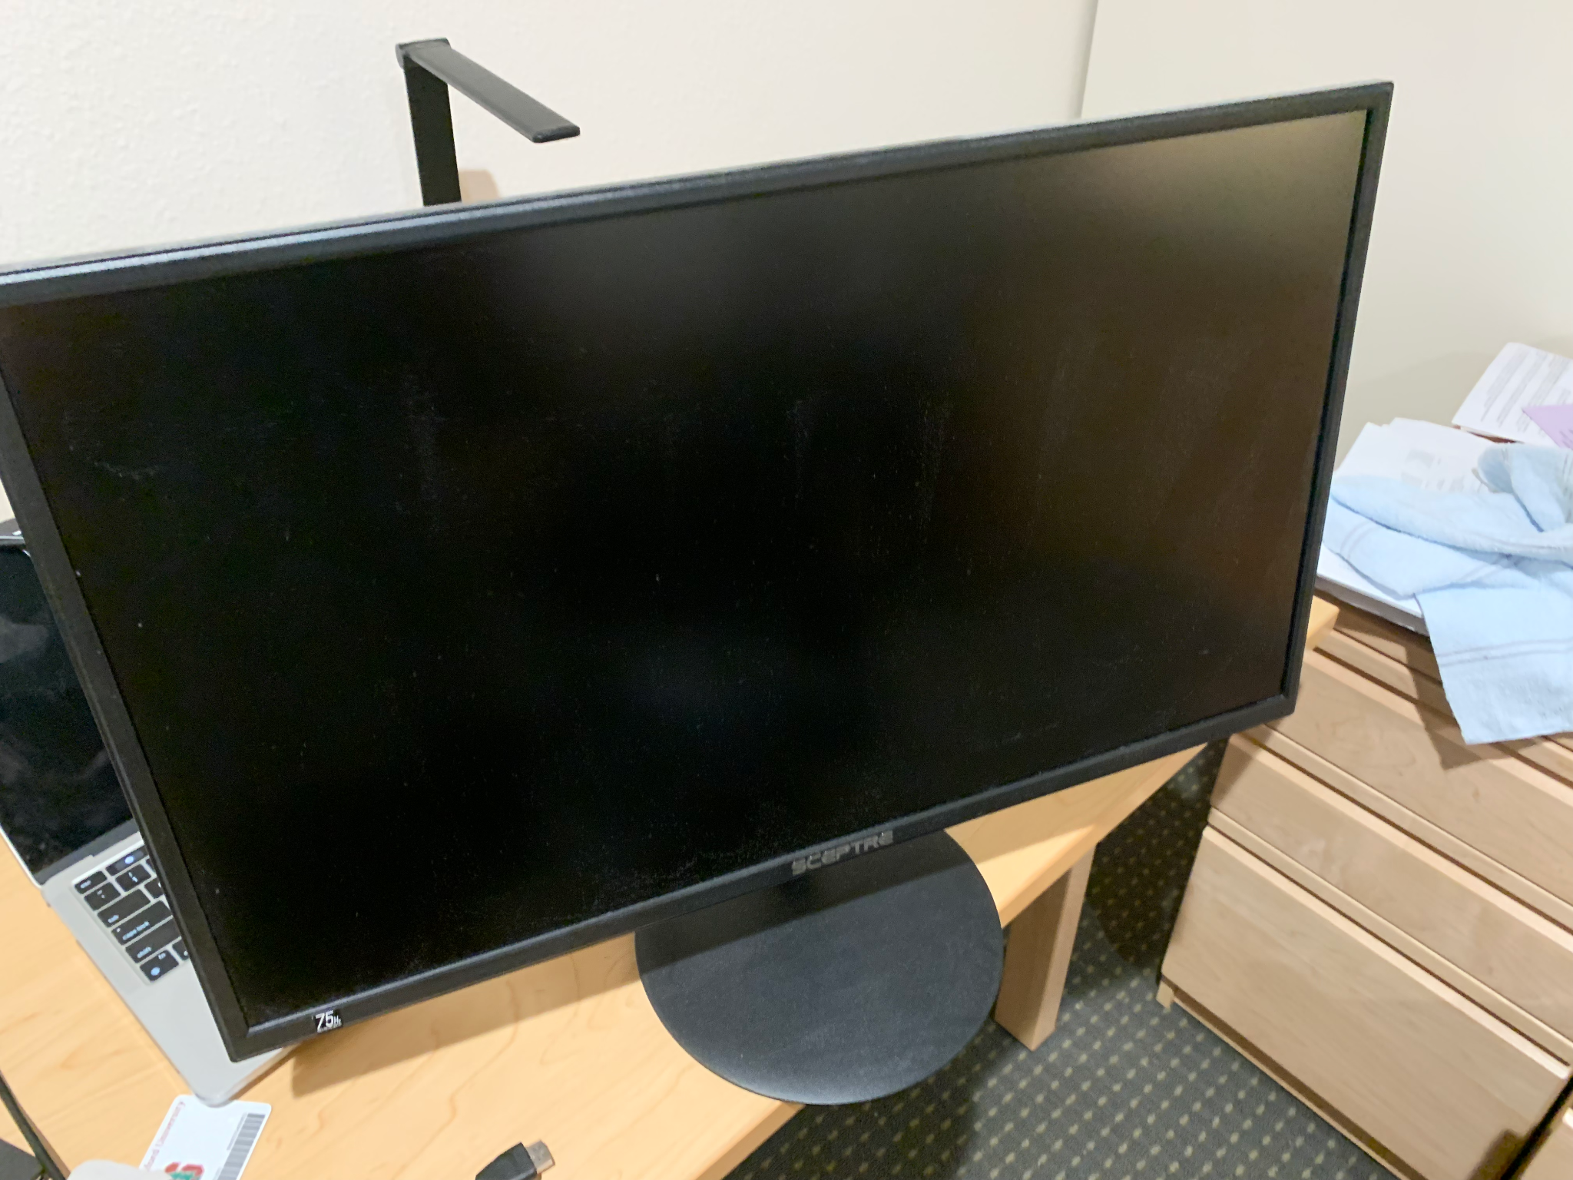
Item: Monitor
Sceptre 27-Inch FHD LED Gaming Monitor 75Hz 2X HDMI VGA Build-in Speakers, Ultra Slim Metal Black
Original price: $163.67
Sale price: $90 (OBO!)
Excellent condition, used for about half a year

Slide 3
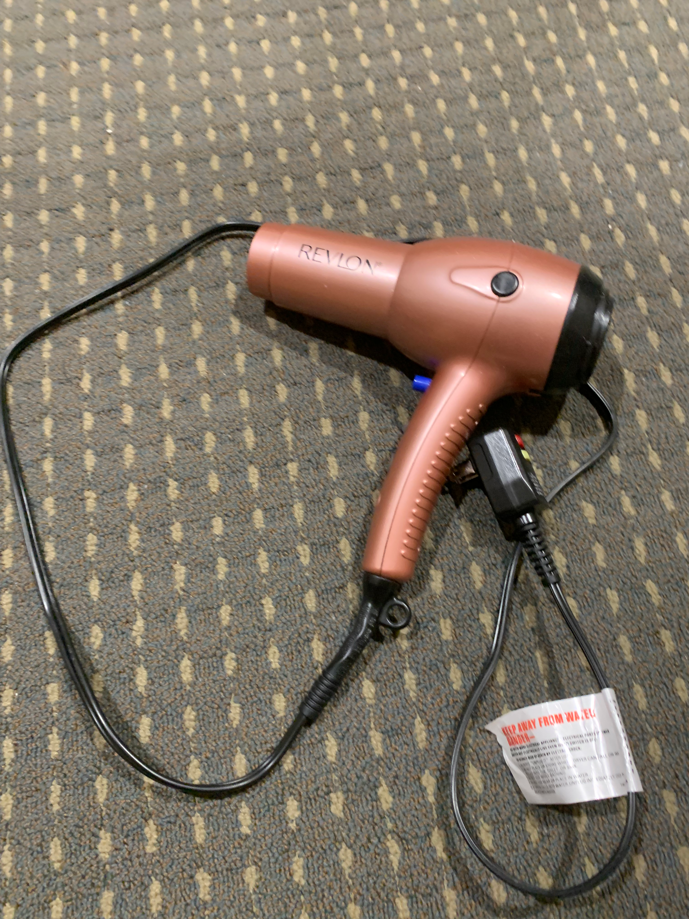
Item: Hairdryer
Original price: $22
Sale price: $15
Used for about under a min/day - excellent condition; comes with a few other contraptions

Slide 4
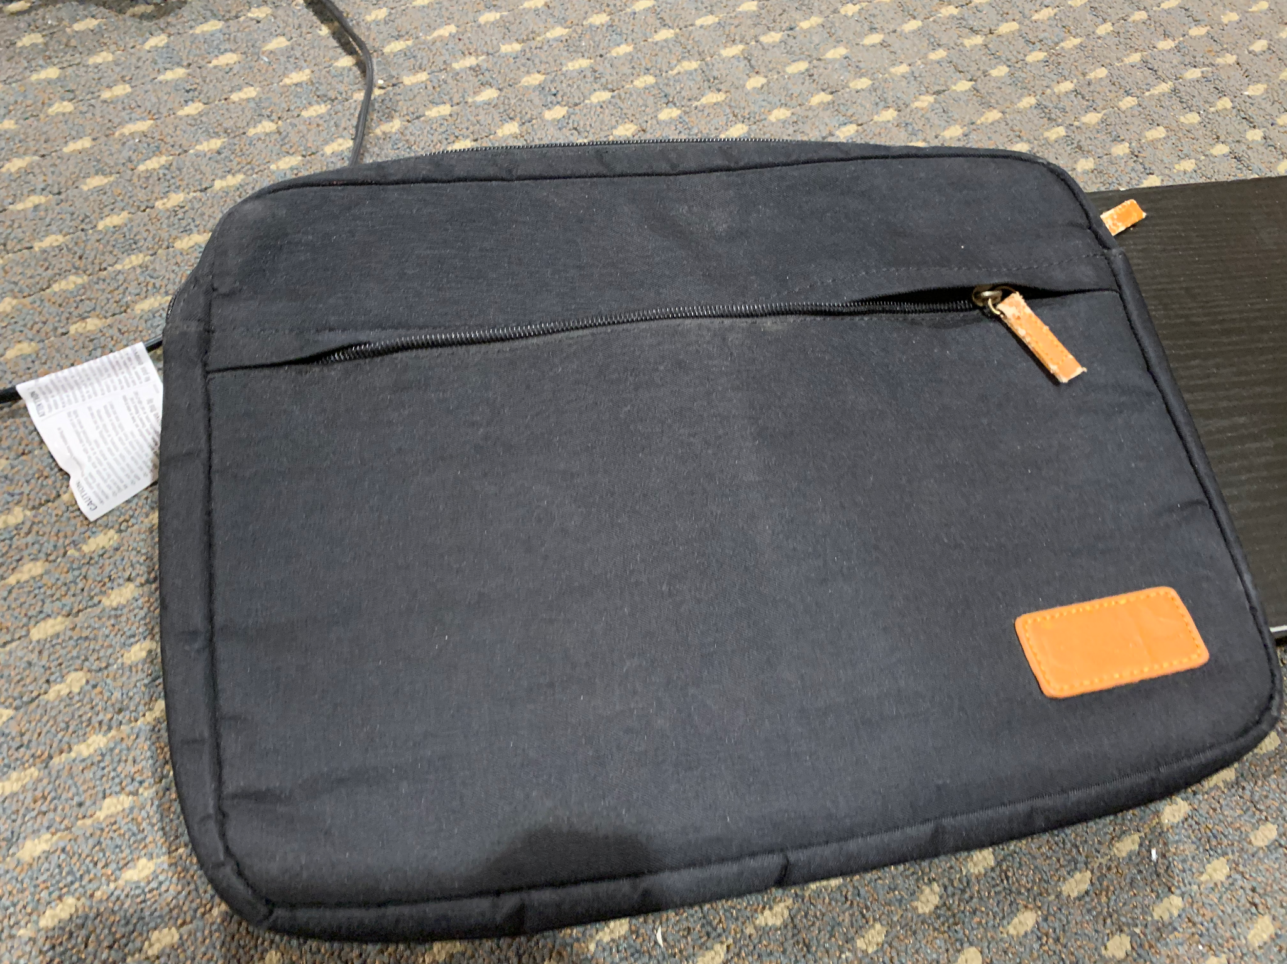
Item: Laptop cover
Original price: $20
Sale price: $5
Never used.

Slide 5
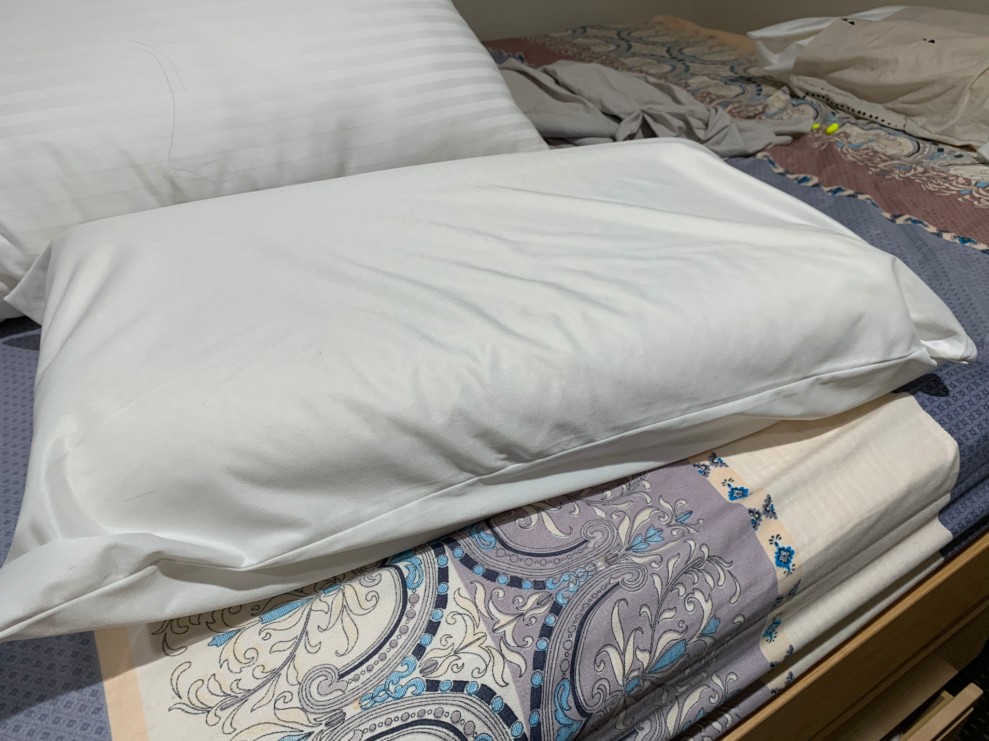
Item: Pillows x 2
(Uttu Sandwich Pillows)
Original price: ~$20 ea
Sale price: $5 ea
As good as new. Never used without a cover.

Slide 6
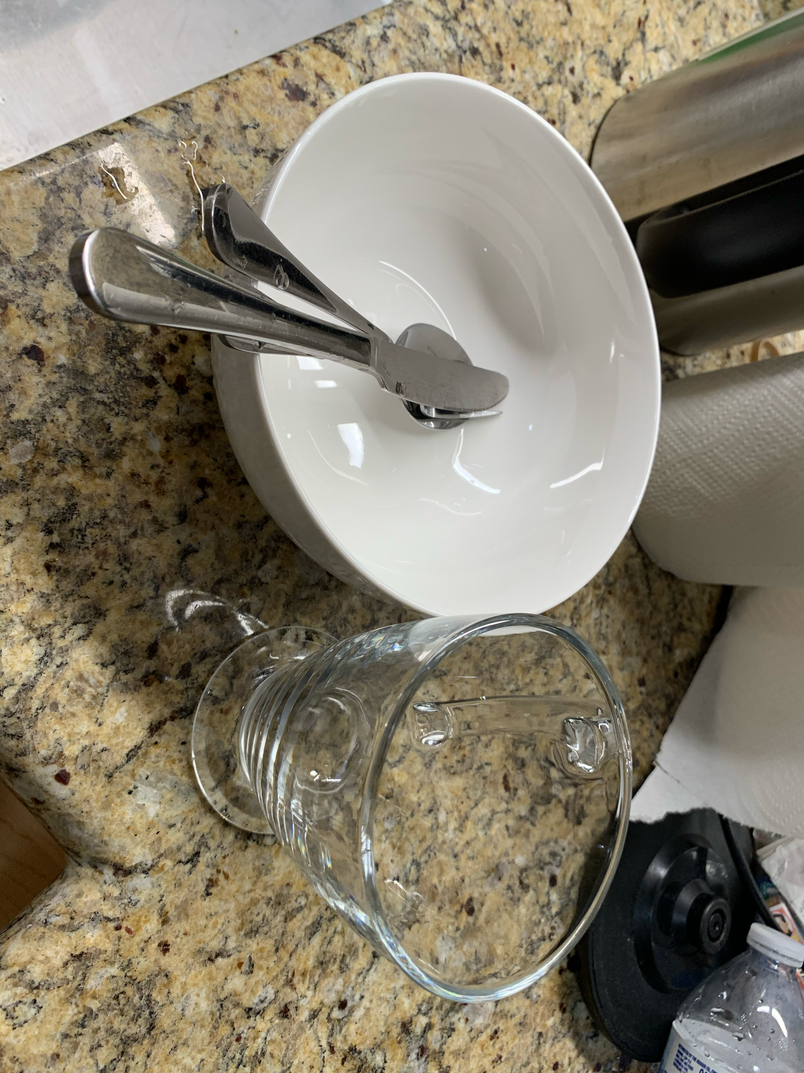
Item: Assorted dishware and cutlery
Original price: Bowls x 4 ($5 ea); Forks and Spoons x 4 + 1 knife (~$10 total); Cups x 6 ($4 ea)
Sale price: $10 (for all)

Slide 7
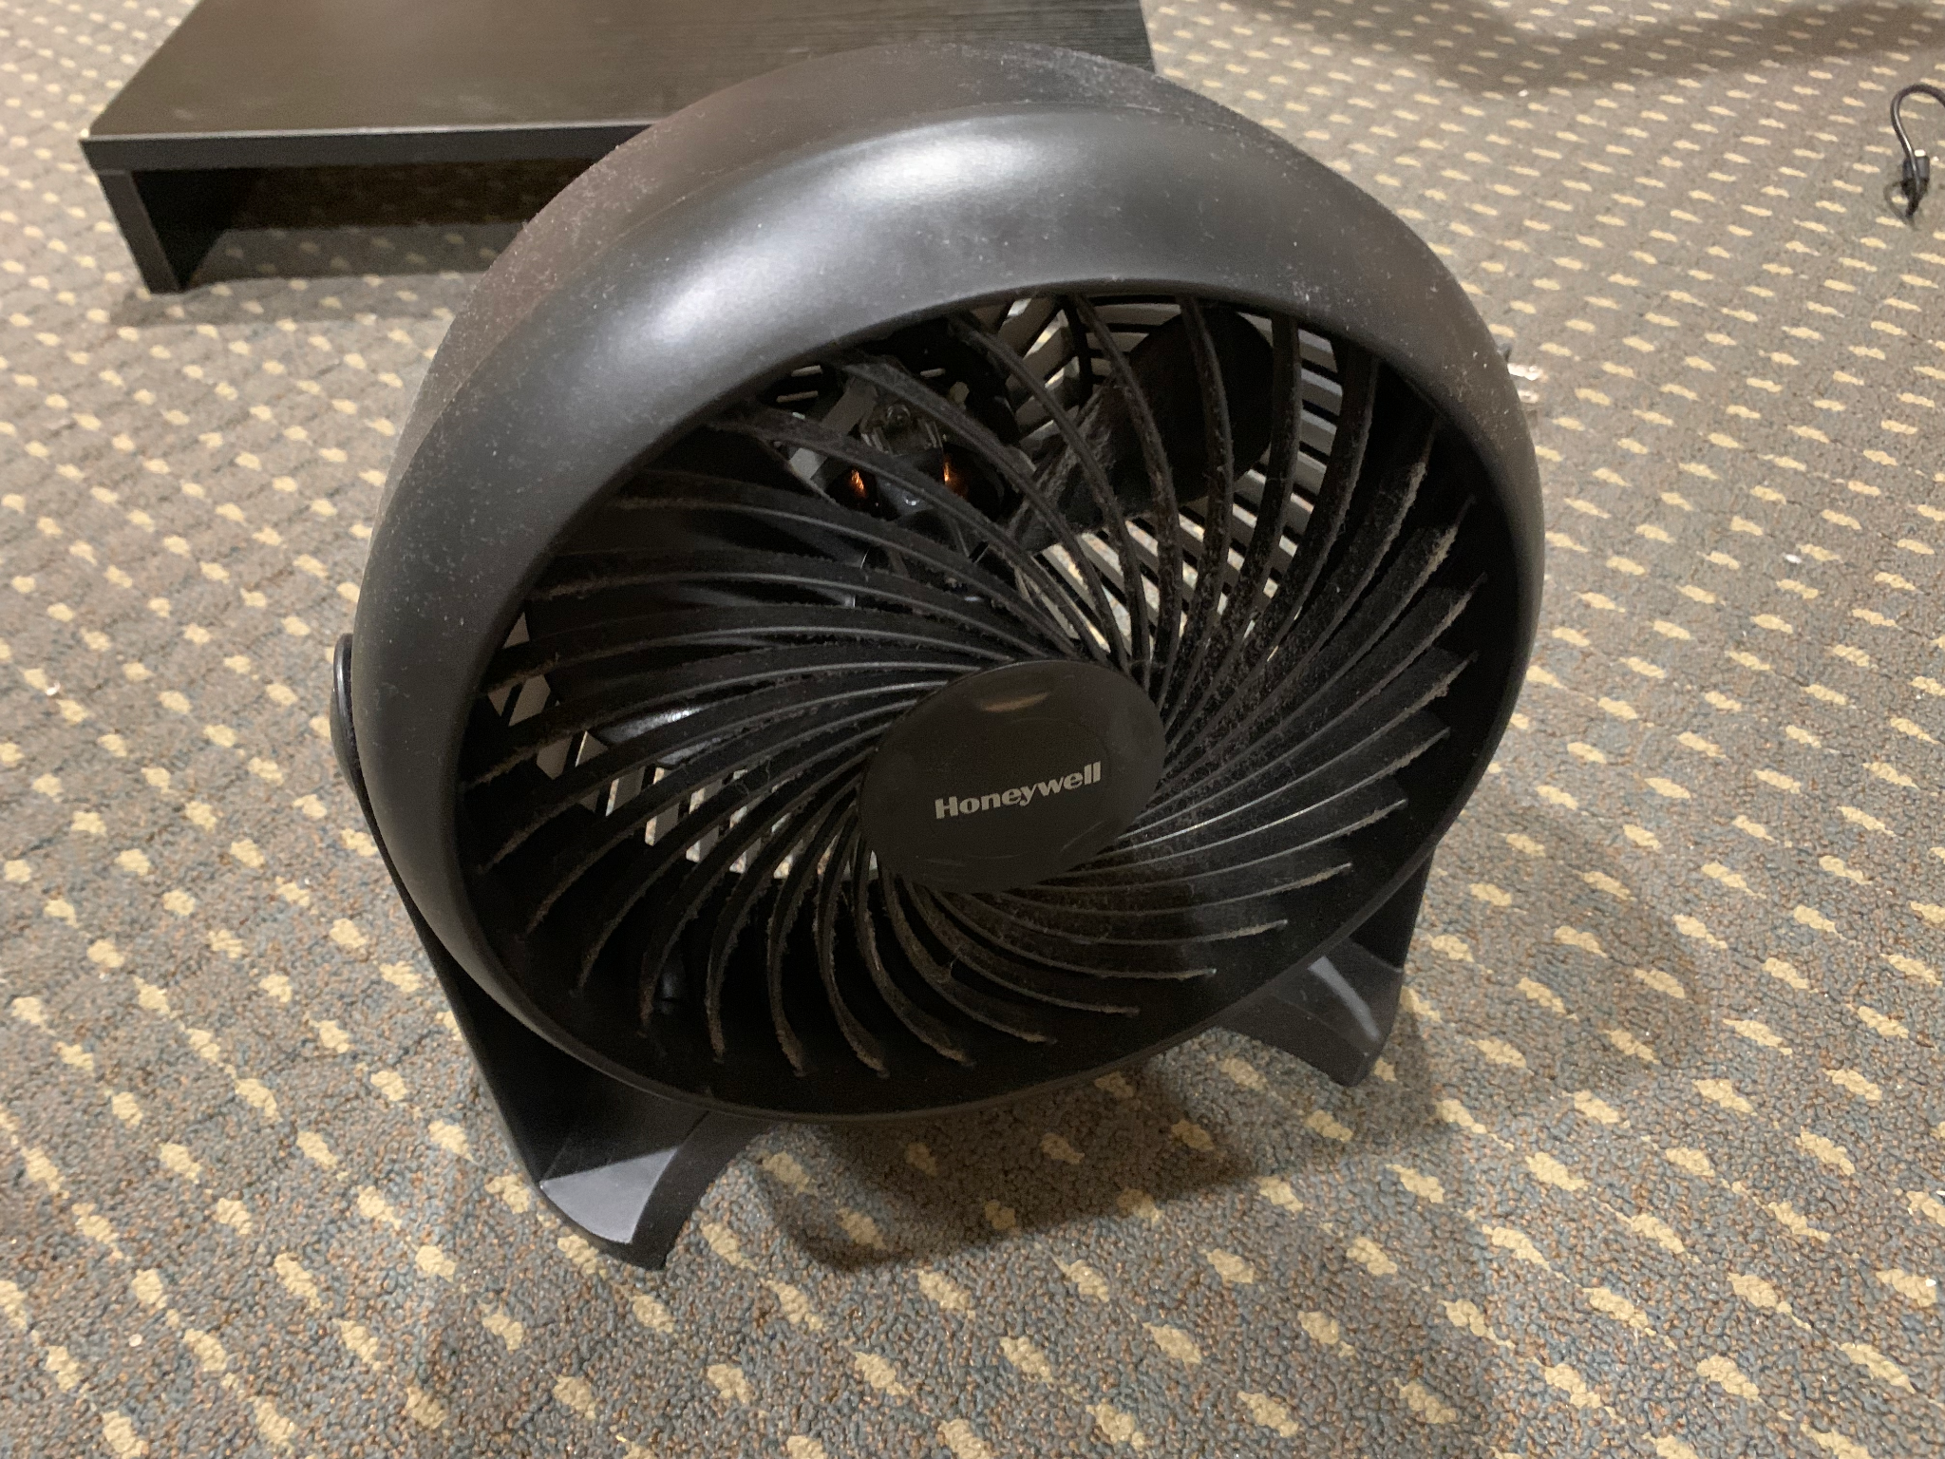
Item: Fan
Original price: ~$30
Sale price: $15

Slide 8
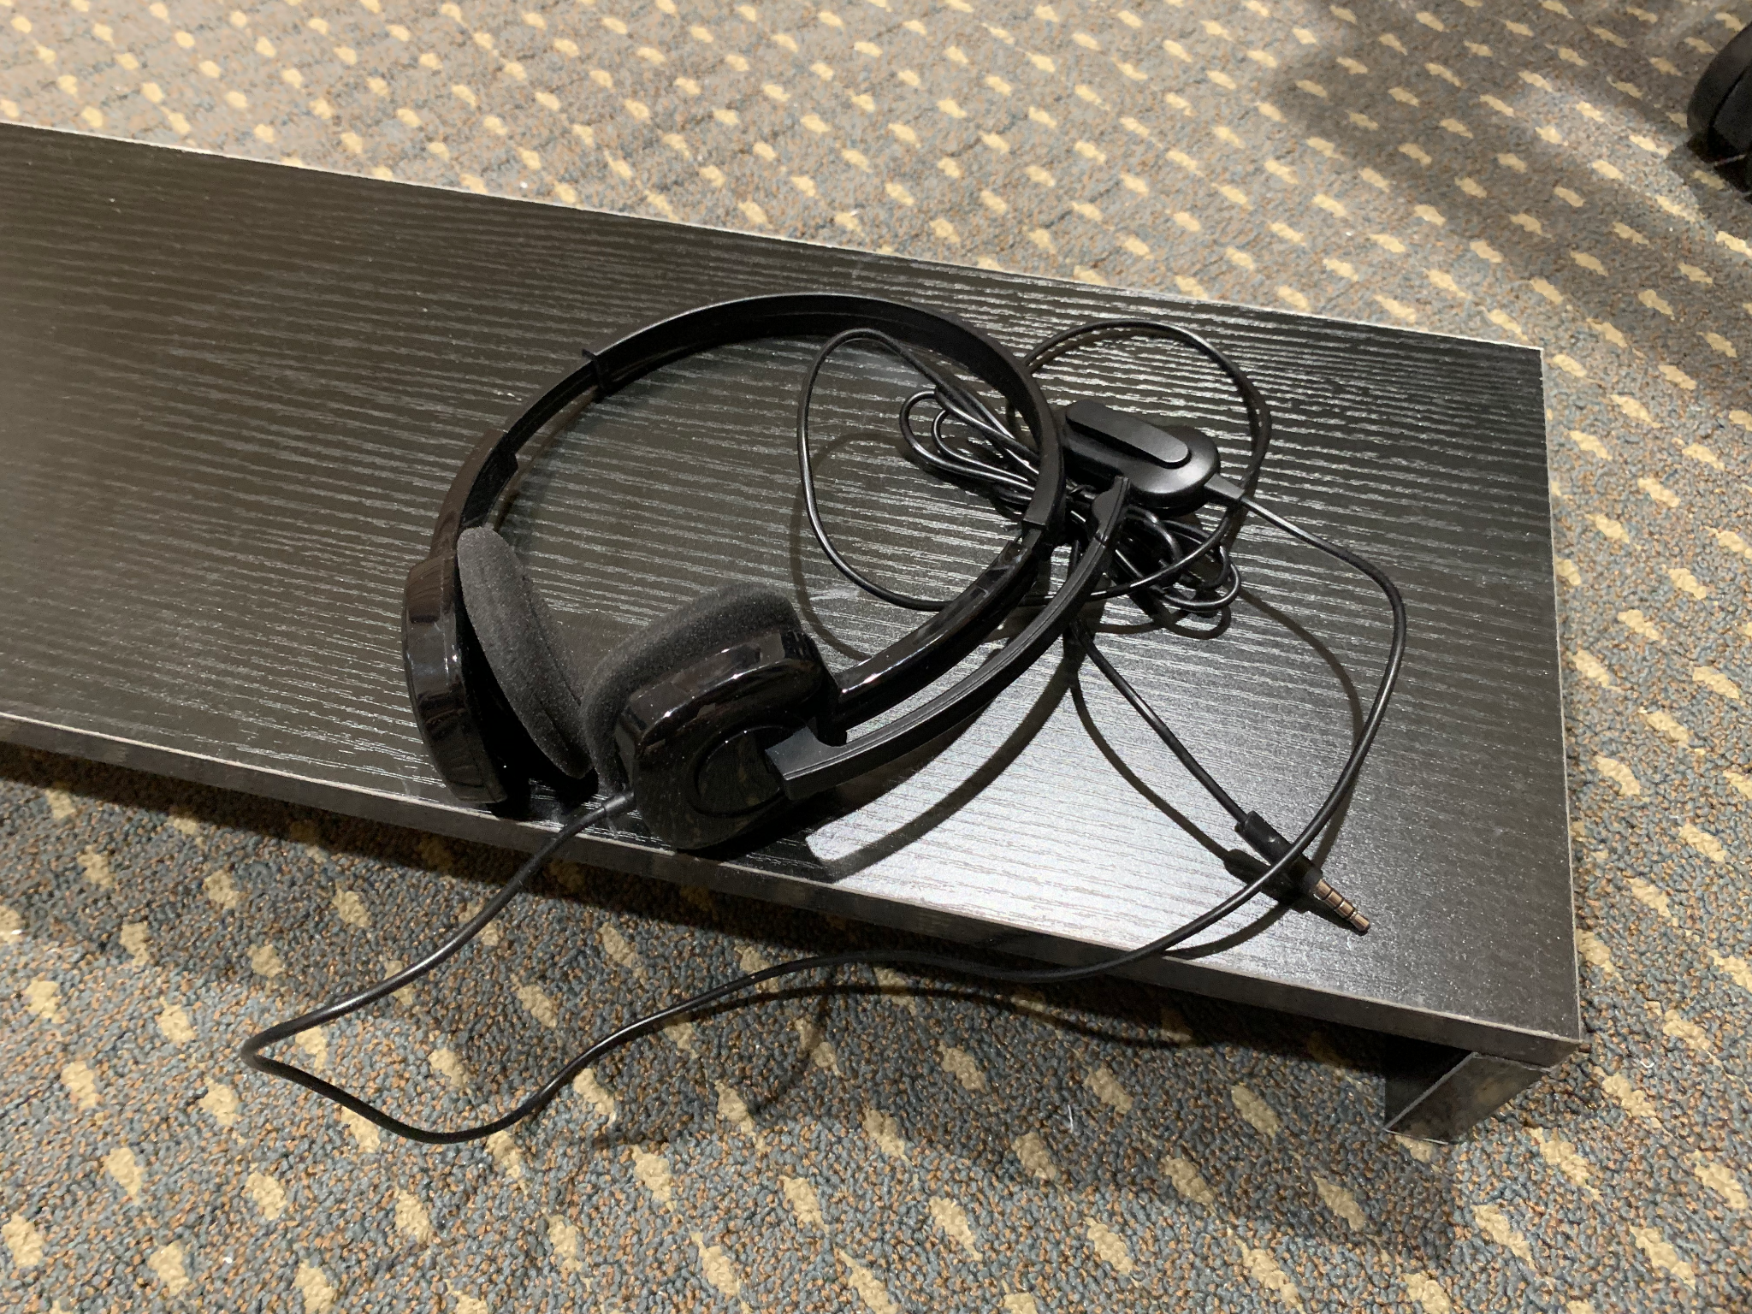
Item: Headset
Original price: ~$20
Sale price: $5
Never used; maybe handy as a backup

Slide 9
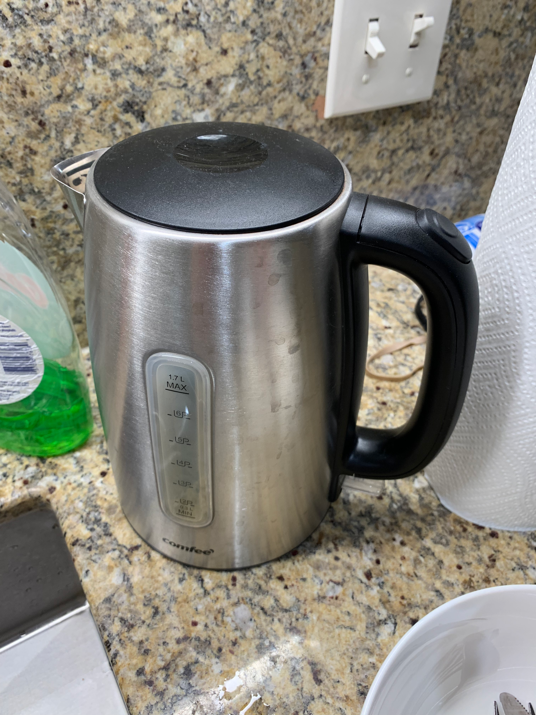
Item: Electric Kettle
Original price: $25
Sale price: $5
Still working very well

Slide 11
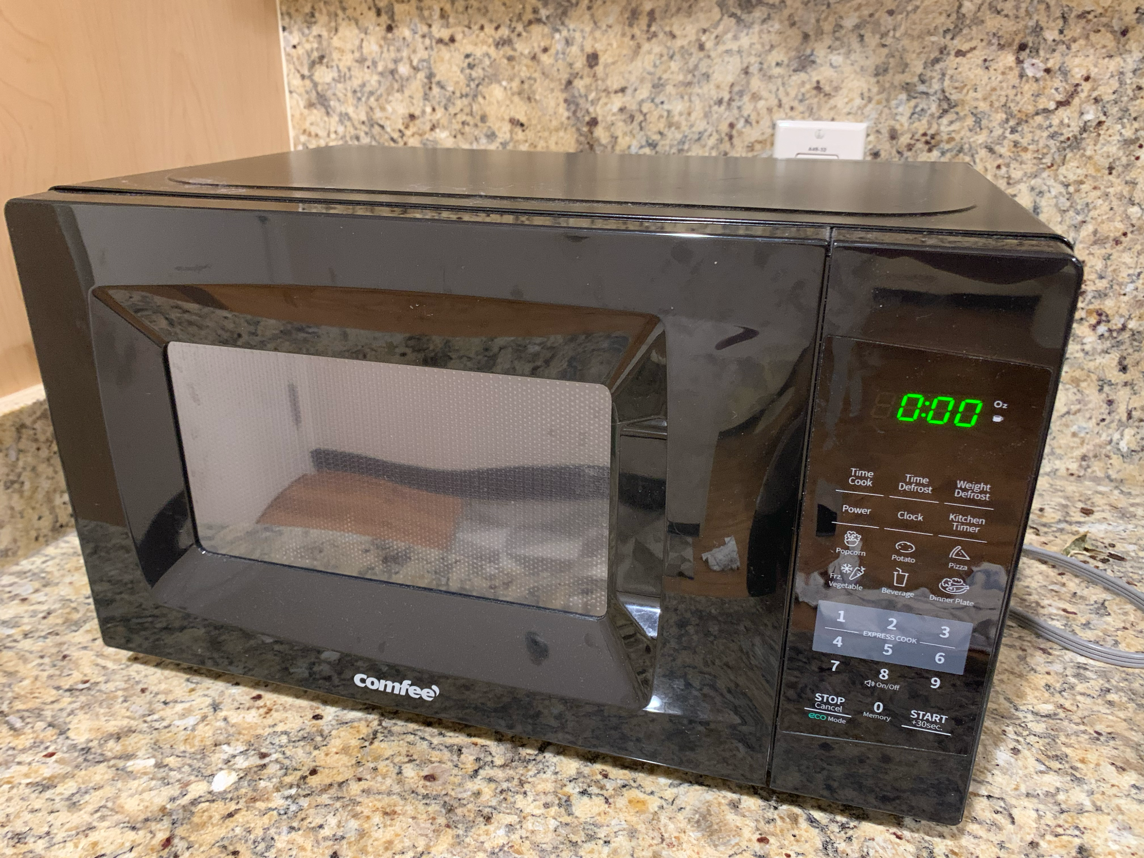
Item: Microwave Oven
Original price: $65
Sale price: $30
A scorch mark at the back of the oven (oops) but 0 impact on functionality.
(RESERVED)

Slide 12
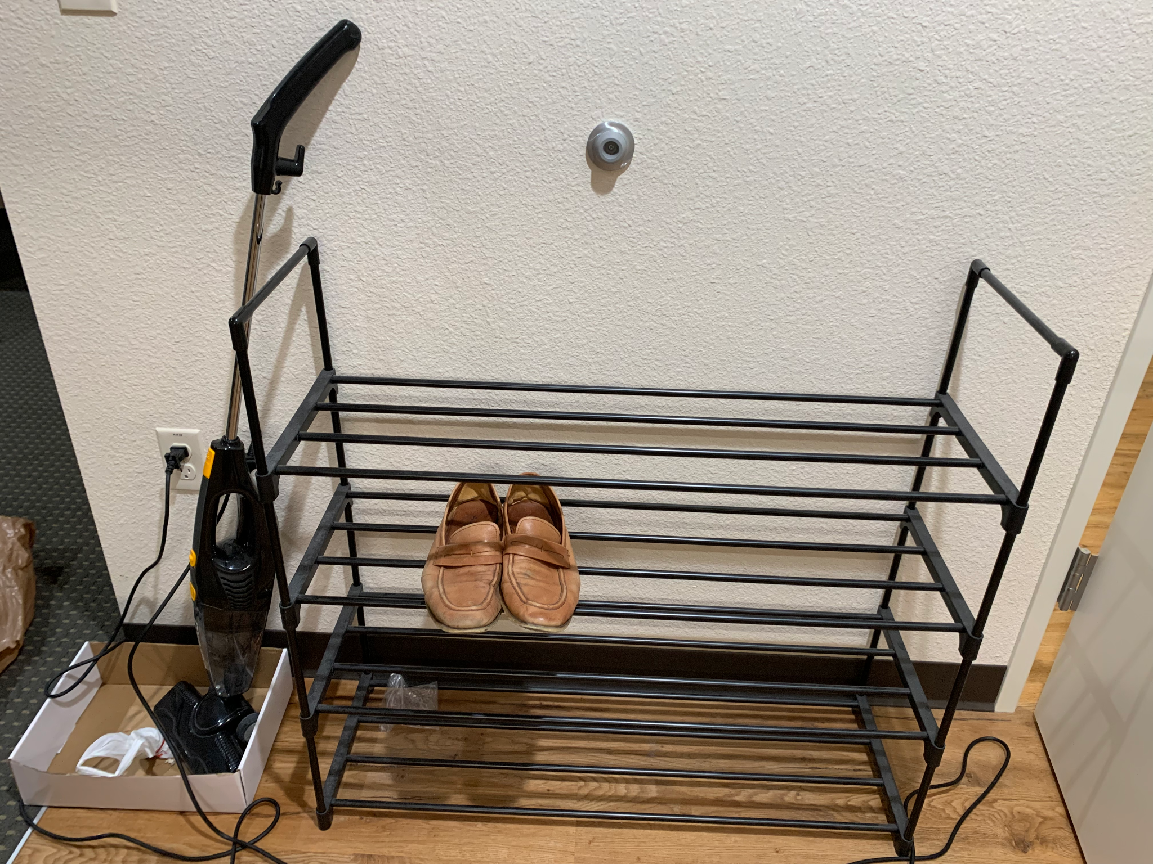
Item: Shoe Rack
Original price: ~$22
Sale price: $10
Already assembled - holds ~20 pairs of shoes.
(RESERVED)

Slide 14
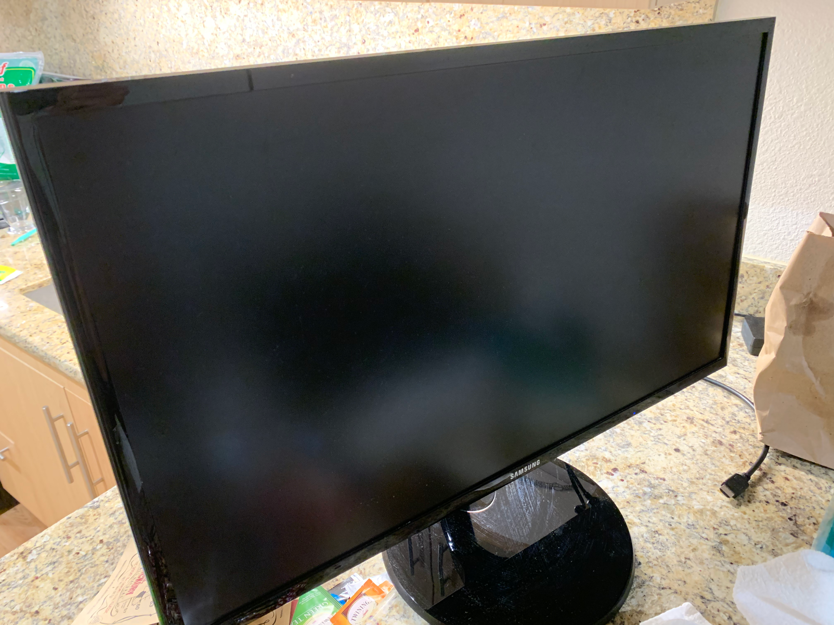
Item: Monitor
SAMSUNG 27" FHD Flat Monitor with Super-Slim Design - LS27F354FHNXZA, Black
Original price: $190
Sale price: $100 (OBO!)
Excellent condition, spare screen that was mainly used during exams
(SOLD)

Slide 15
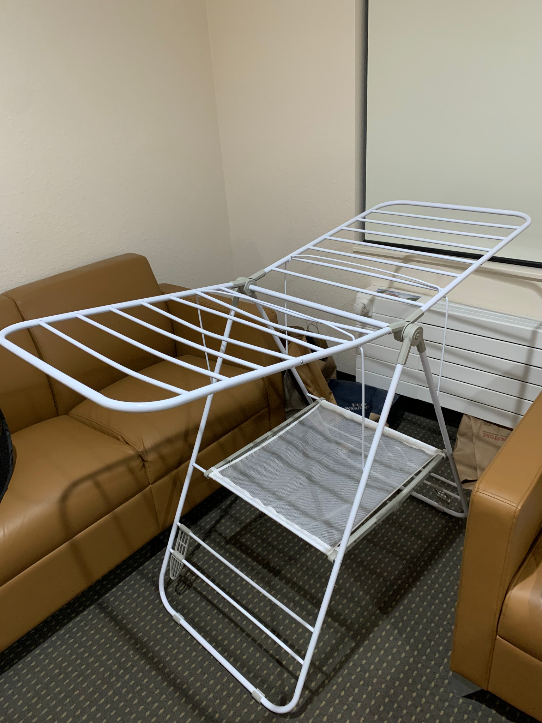
Item: Clothes rack
Original price: $36
Sale price: $12
Will throw in clothes hangers too
(SOLD)

Slide 16
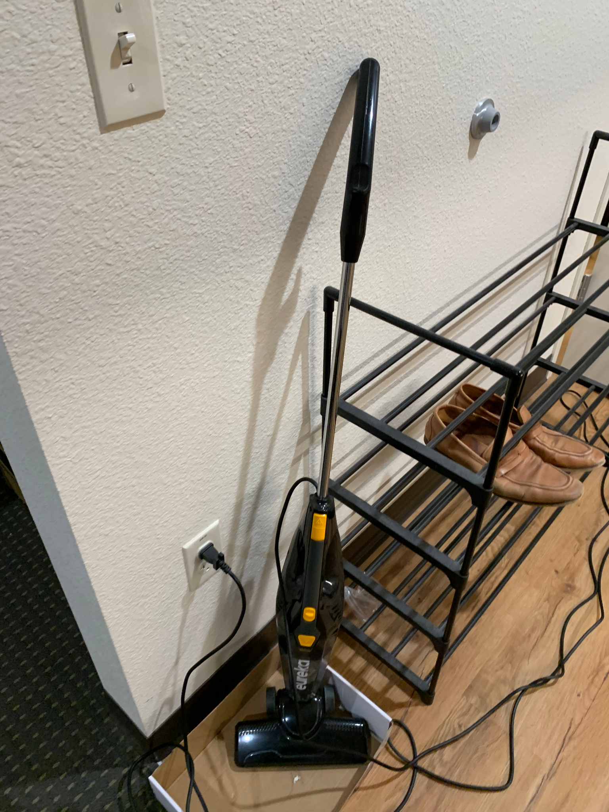
Item: Eureka Blaze 3-in-1 Swivel Lightweight Stick Vacuum
Original price: ~$32
Sale price: $15
Used every now and then.
(SOLD)

Slide 17
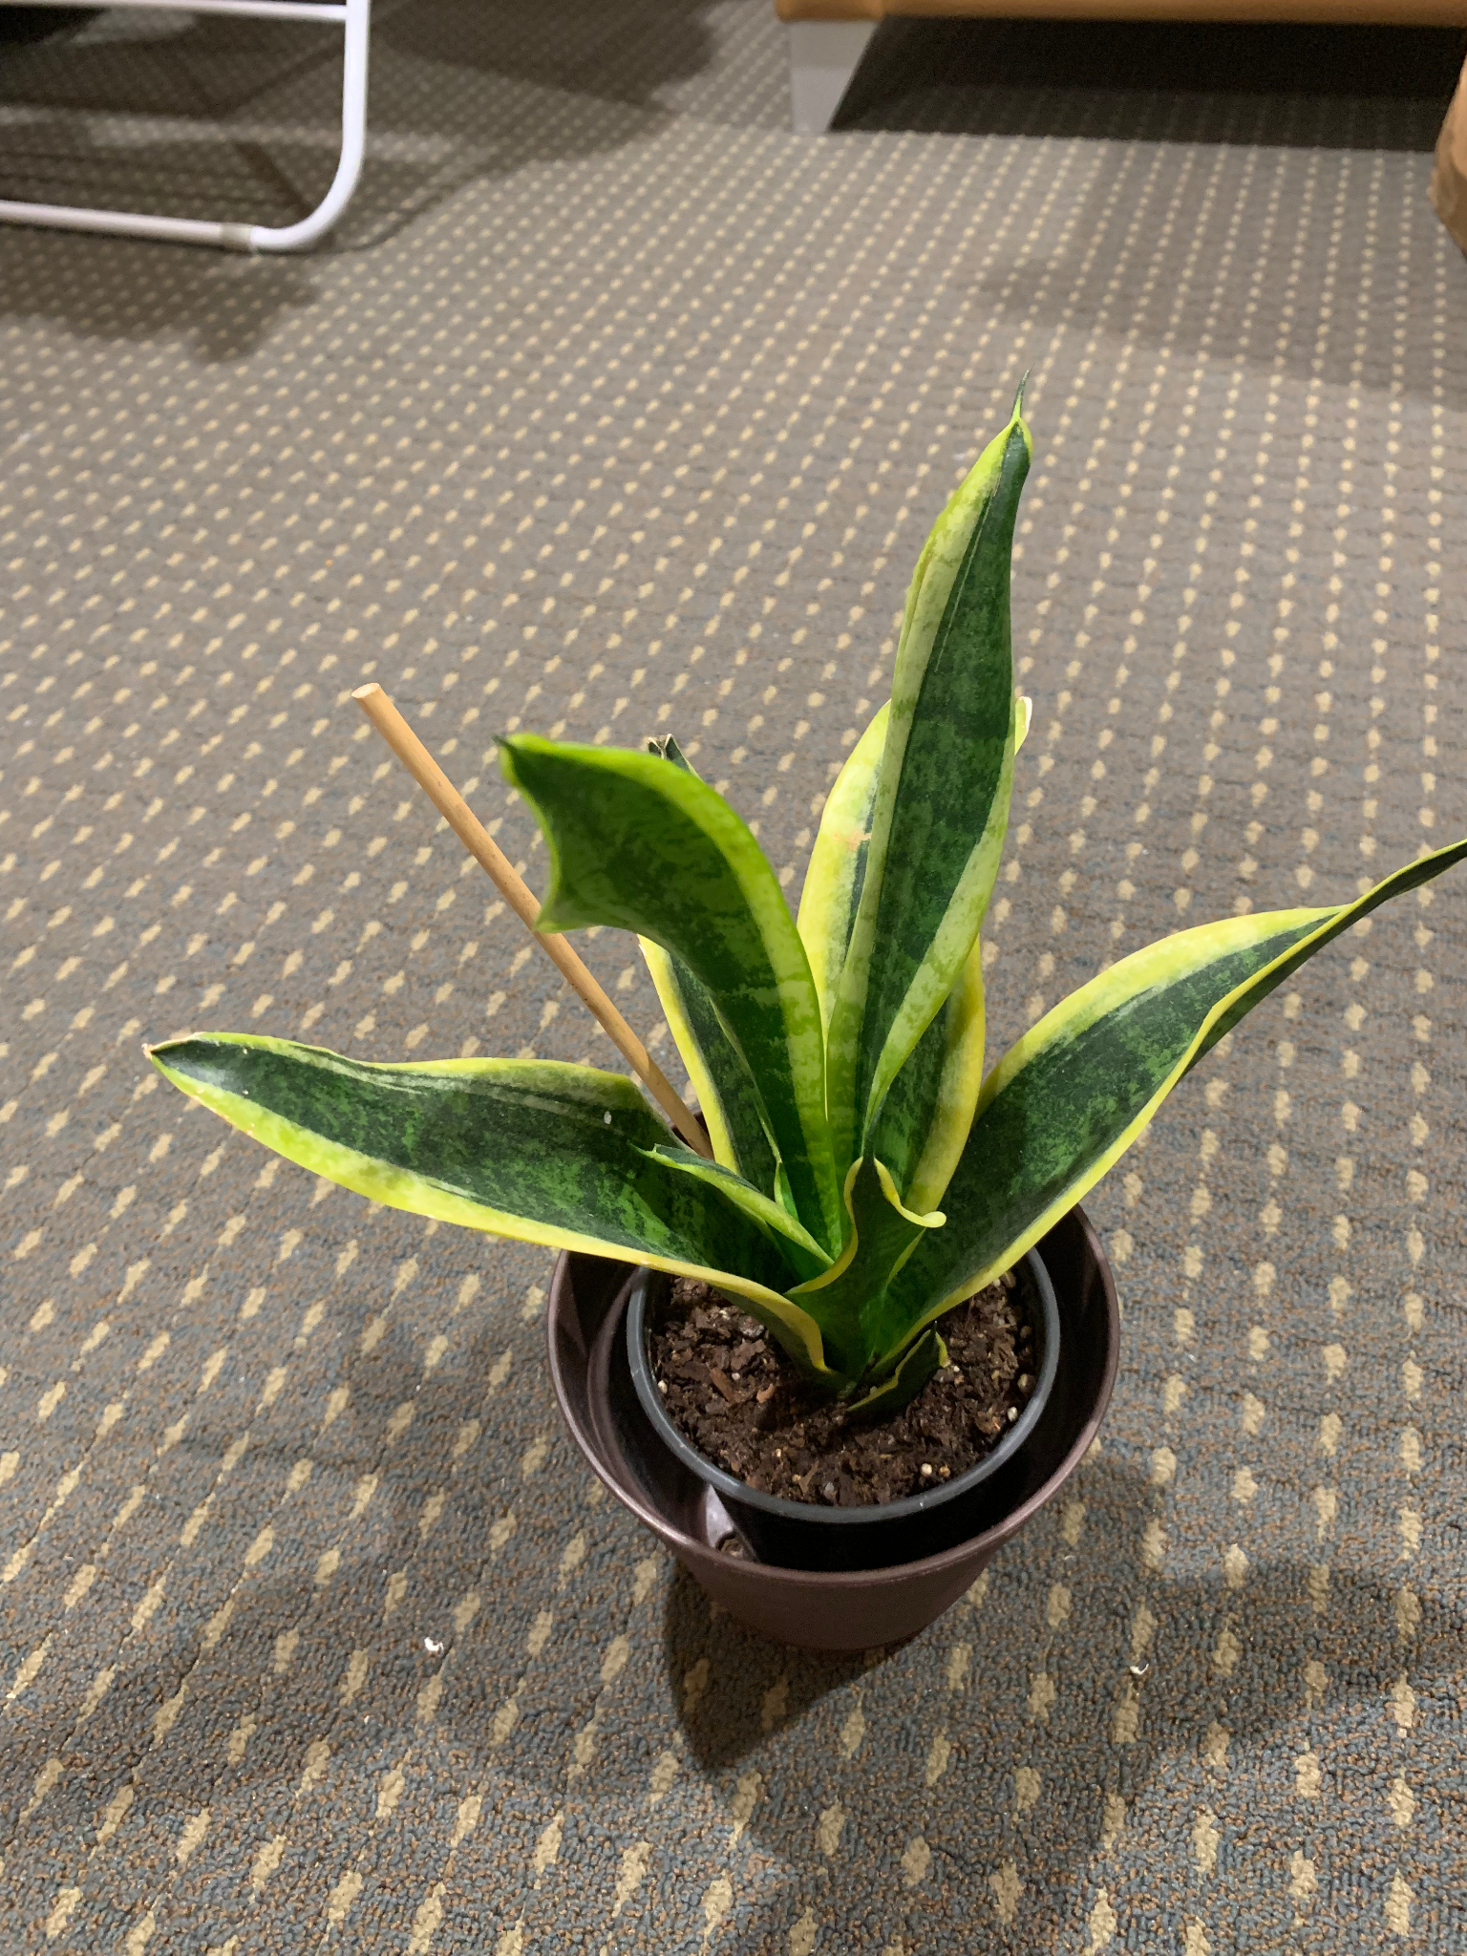
Item: Potted Succulent Plant
Original price: ~$15
Sale price: $5
Good vibes. Be a plant parent!
Open to giving this away along with purchase of monitor.
(SOLD)

Slide 18
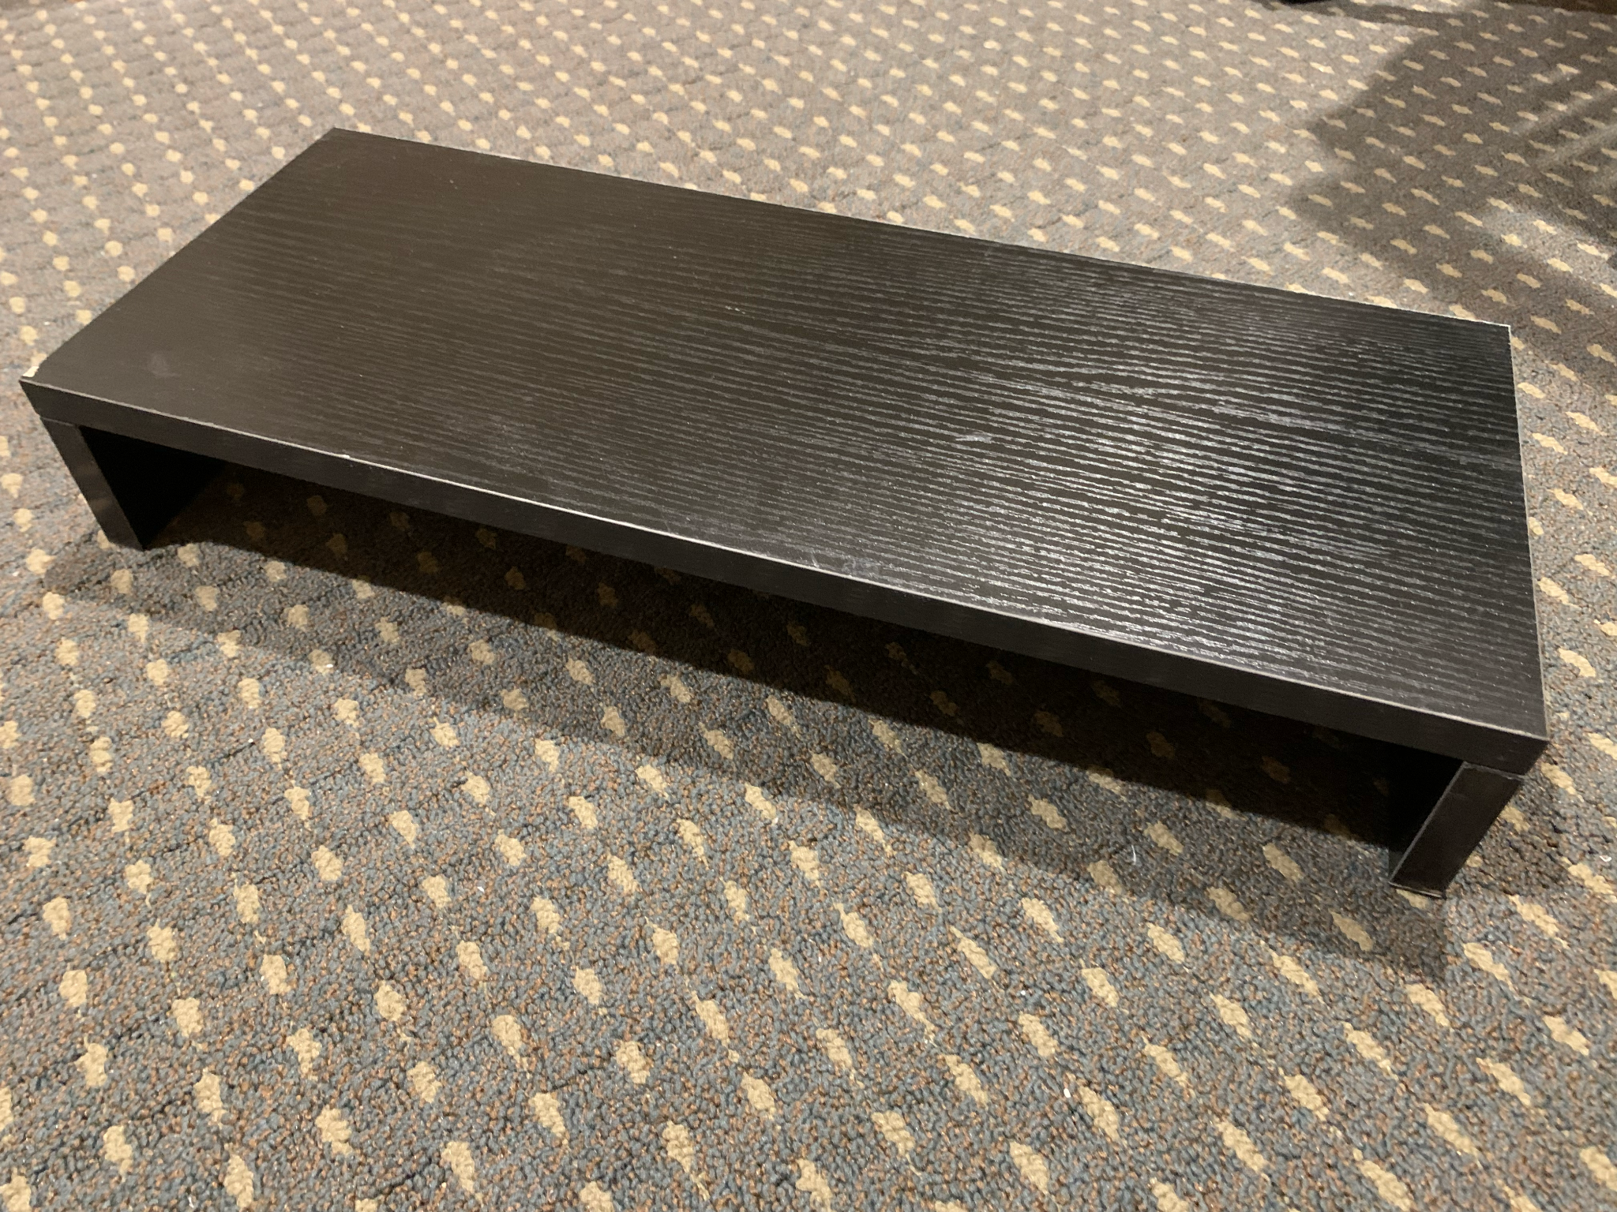
Item: Monitor Stand
Original price: $20
Sale price: $10
Great height so you can have the laptop right below the screen if that’s a config u like.
Open to giving this away along with purchase of monitor.
(SOLD)

Slide 19
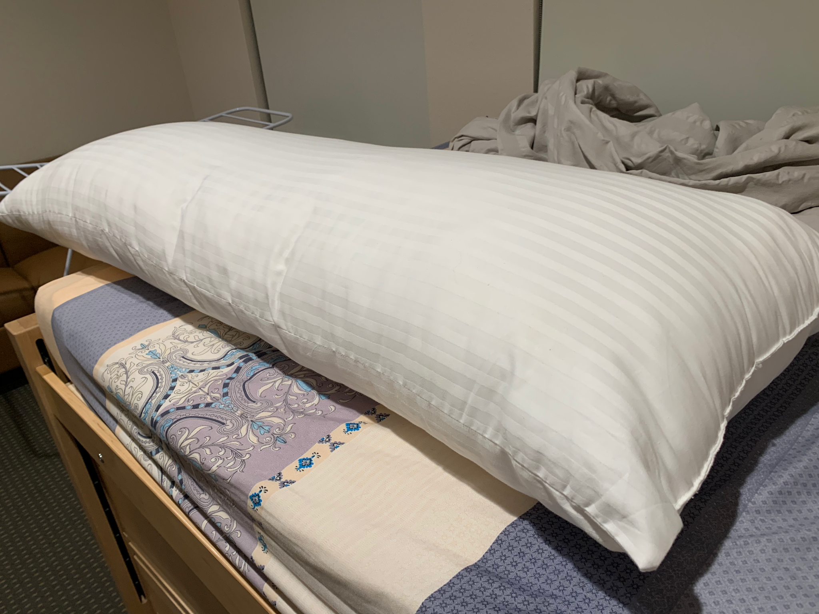
Item: Long Pillow
(Utopia Bedding Soft Body Pillow - Long Pillows for Side and Back Sleepers - Cotton Blend Cover with Soft Polyester Filling (20x54 Inch))
Original price: ~$22
Sale price: $5
A bolster of sorts - pretty comforting. Never used without a cover.
(SOLD)

Slide 20
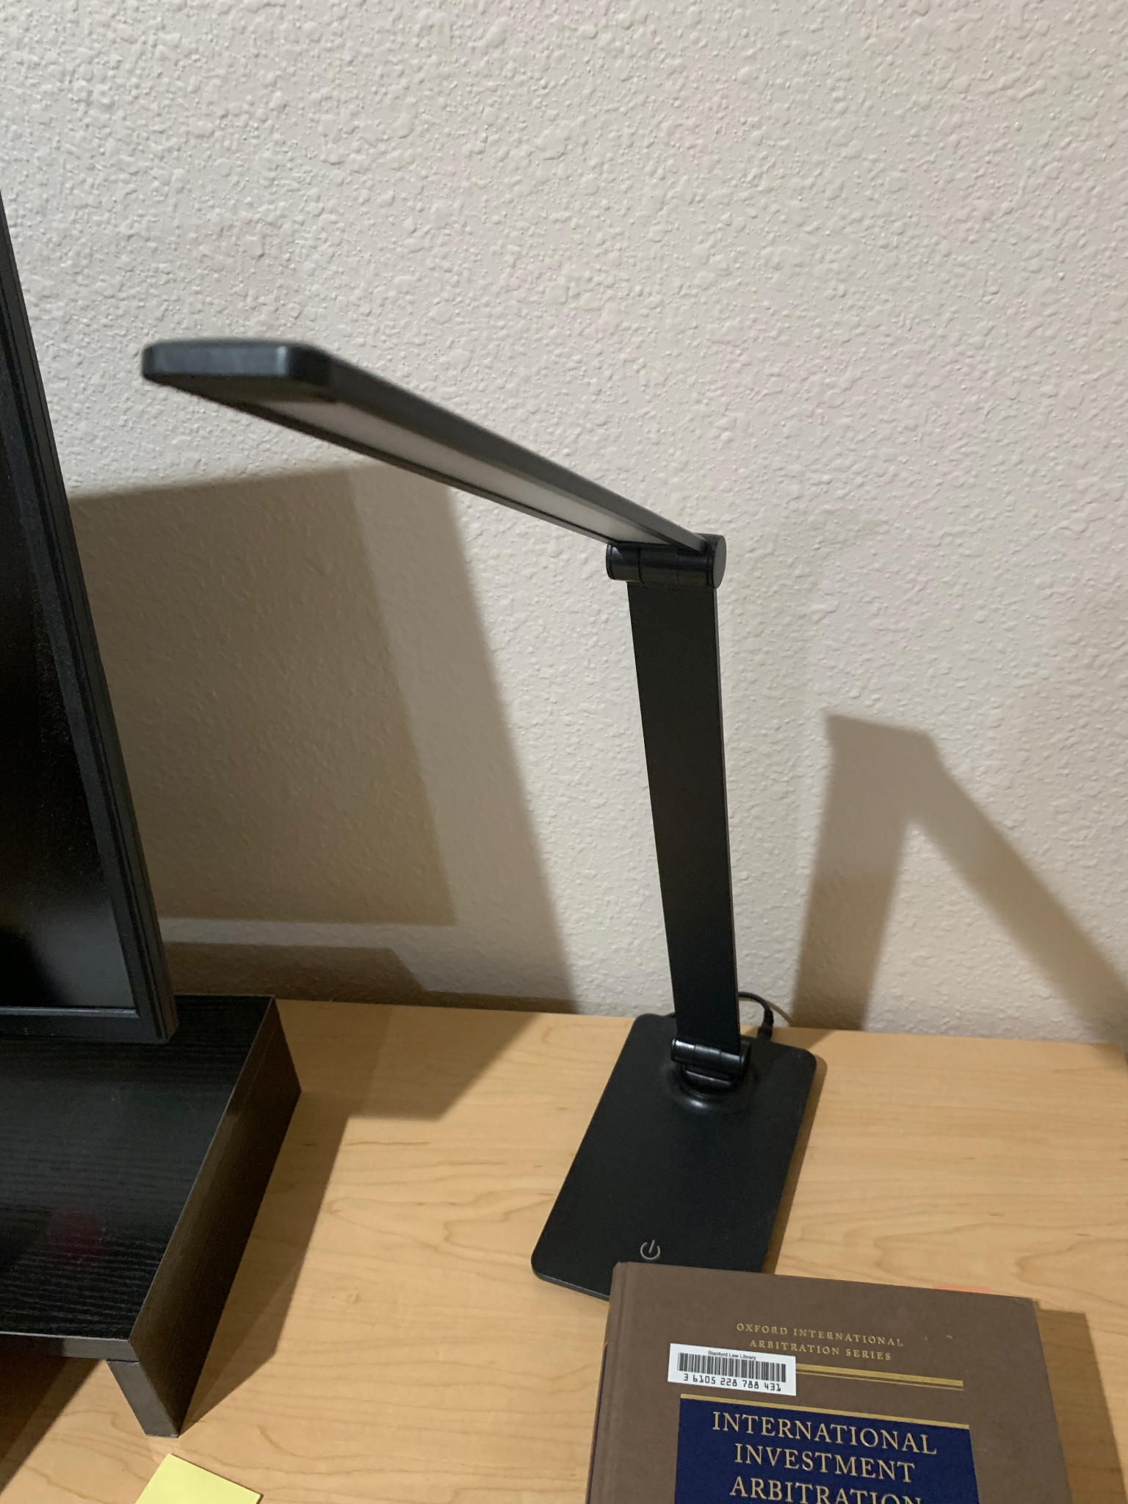
Item: Foldable desk lamp with 3 settings
Original price: ~$17
Sale price: $8
Great for extra lighting; must-have for EVGR desks
(SOLD)

Slide 21
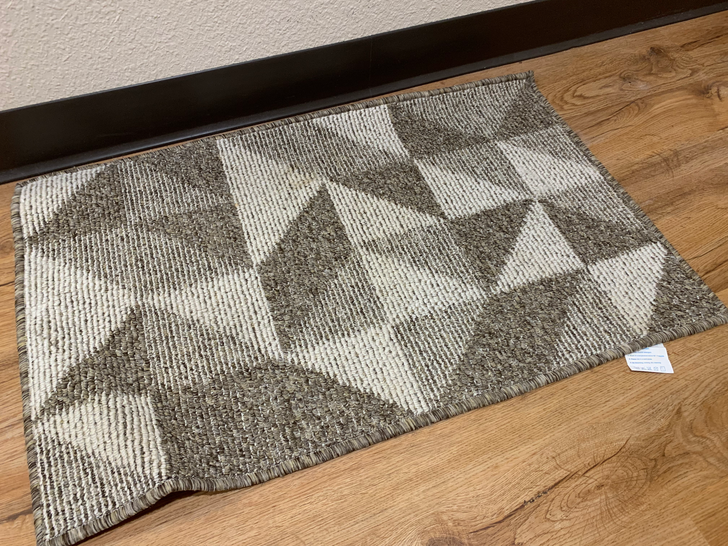
Item: Non-slip Doormat
Original price: $10
Sale price: $5
Barely used
(SOLD)

